Slide 1
PERFORMANCE
REVIEW
Bright Coffee Sales
Presented By
VÜMBONI MSIMANGO

Slide 2

EXECUTIVE
SUMMARY
A New Standard for Focus and Productivity
Performance Overview
A productivity café designed to empower focus through tech-driven, sensory-friendly environments.
Category Performance
Comparisons of profits across product categories and store locations.
Store Insights
Sales and profit across Astoria, Hell’s Kitchen, and Lower Manhattan.
Time Trends
Profit by month, weekday vs weekend, and time of day.

Slide 3
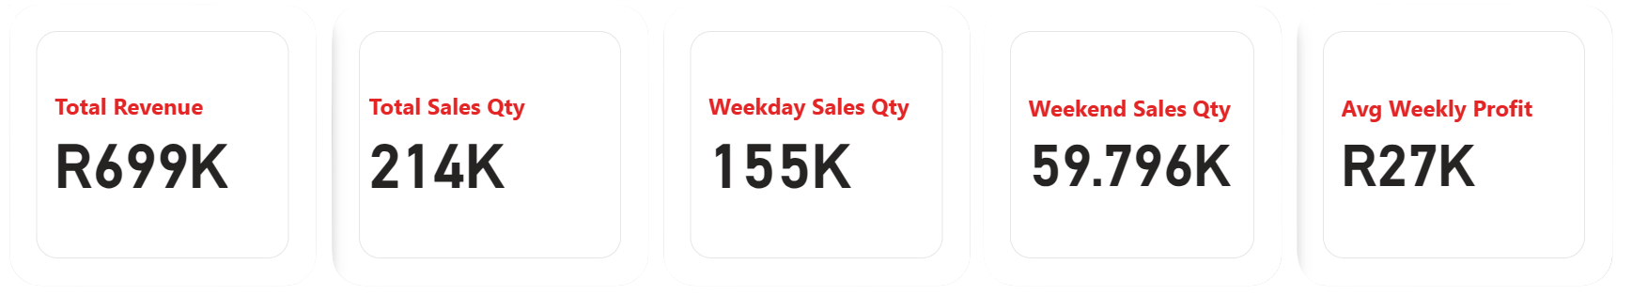
KEY PEFORMANCES
OBJECTIVES
Year-to-Date Performance
Bright Coffee has generated R699K in total revenue so far this year.
Across all stores, we recorded 214K sales transactions.
Weekdays are the main driver, with 155K sales, while weekends add 59.8K sales, showing steady customer activity outside the work week.
On average, the business delivers R27K in weekly profit, reflecting consistent performance throughout the year.
1

Slide 4
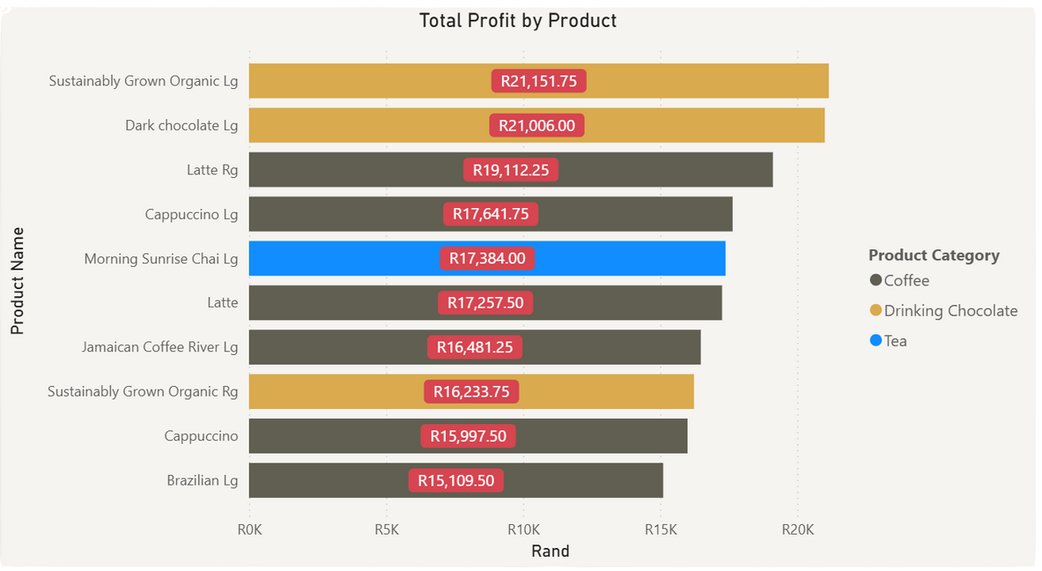
MARKET
ASSESSMENT
Trends
This shows the Top 10 performing products.
Sustainably Grown Organic Lg leads with just over R21K profit, slightly ahead of Dark Chocolate Lg.
Coffee products (Latte, Cappuccino, Brazilian, Jamaican Coffee) take 6 of the top 10 spots, showing it is the core profit driver.
Both Sustainably Grown Organic Lg and Dark Chocolate Lg prove that chocolate-based drinks compete closely with coffee for profit share.
Morning Sunrise Chai Lg is the only tea in the top 5, contributing strongly with R17K+ profit, signaling niche demand.
Most top products are within a R15K–R21K profit range, meaning no single product overwhelmingly dominates.
2

Slide 5
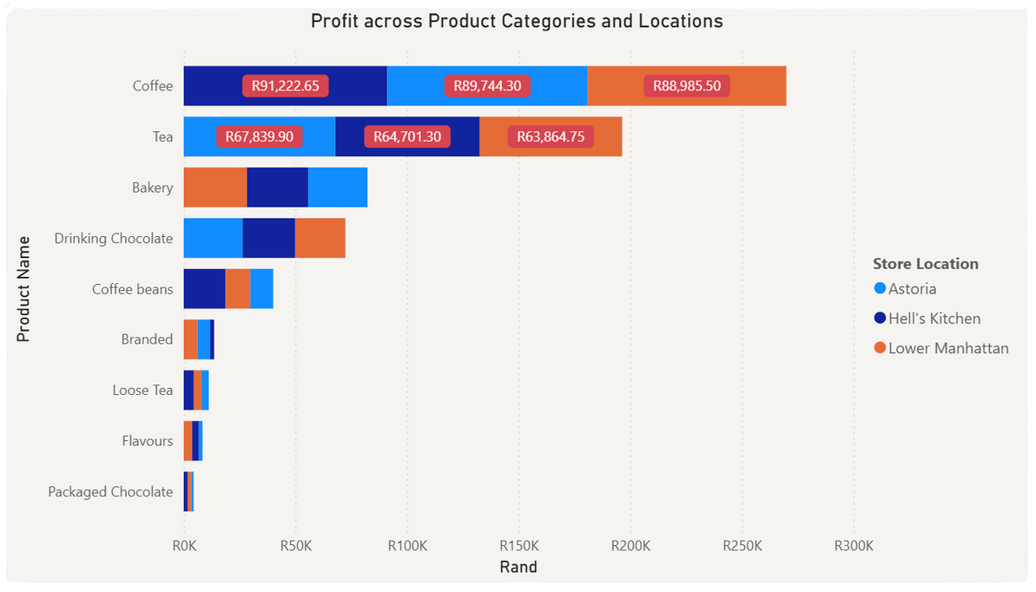
CATEGORY PERFORMANCE
Trends
This shows the Top 10 performing categories.
Coffee generates the highest profit, over R270K combined, making it the backbone category across all stores.
Tea is strong, with profits exceeding R195K in total. Tea stands as the second-largest contributor, demonstrating steady demand.
Both Bakery & Drinking Chocolate provide meaningful but smaller contributions, positioning them as support categories rather than drivers.
Coffee beans, Branded, Loose Tea, Flavours, and Packaged Chocolate are niche contributors with much lower profit impact.
Coffee and Tea perform well in Astoria, Hell’s Kitchen, and Lower Manhattan, showing broad customer appeal.
3

Slide 6
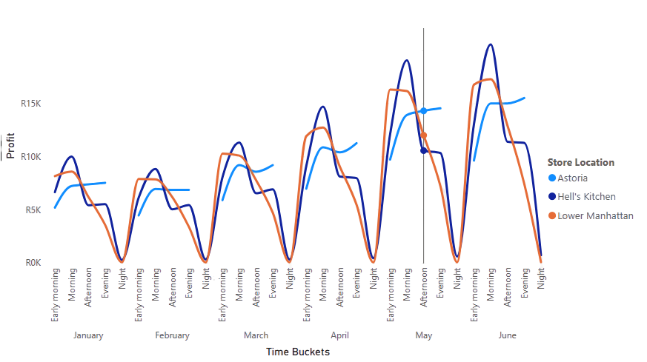
LOCATION
PERFORMANCE GAPS
Trends
Hell’s Kitchen leads consistently peaks higher than other stores, especially in the Afternoon and Evening slots.
Astoria shows steady growth over the months, with smoother profit lines compared to others. It also doesn’t operate at Night.
Lower Manhattan fluctuates displays volatility, with sharp highs and lows across time buckets.
All stores see biggest profit spikes in the Evening, making it the strongest time bucket across locations.
Profits drop across all stores in Early Morning and Night, suggesting low customer activity then.
4

Slide 7
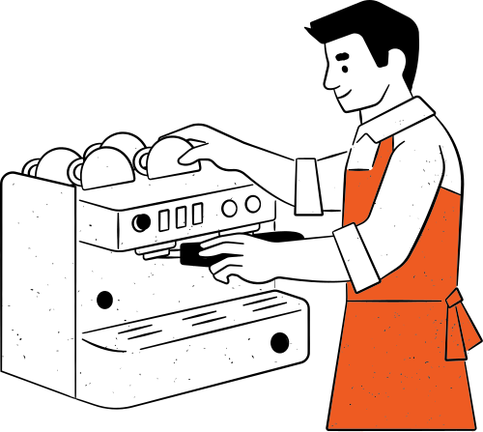
KEY
TAKEAWAYS
We have had a strong year to date with R699K revenue and 214K sales confirm steady growth.
Coffee leads the way and remains the most profitable and consistent category across all stores.
155K weekday sales vs 59.8K weekend sales highlight where demand is strongest.
Profit peaks consistently in afternoon and evening time buckets.
Hell’s Kitchen drives higher peaks, while Astoria is the most stable performer.
Tea and Drinking Chocolate provide strong secondary contributions alongside Coffee.
An average of R27K profit weekly shows reliable performance.
5

